Slide 1
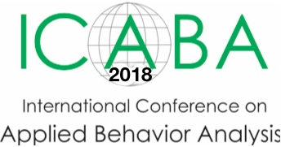

Psychological well-being in children with autism and their family members: Implications for family support
Richard Hastings
Cerebra Chair of Family Research, University of Warwick, UK
Monash Warwick Professor, Department of Psychiatry, Monash University, Australia
@ProfRHastings

Slide 2
Behaviour problems in ASD
In clinical settings, the main focus is to identify the factors maintaining “challenging behaviour” for an individual child or adult with autism
Less clinical interest in the factors related to behaviour problems in the population of children with autism
Understanding behaviour problems at a population level is a good way to inform the design of services and supports for children and their families
From a PBS/ABA perspective, we implicitly recognise the influence of family members on a child with autism, but less often consider family support needs

Slide 3
Behaviour problems in the population of children with autism

Slide 4
Questions, and context
How exactly you ask a question at least partly determines the answer you get
  Well-established measures: e.g., assessing child behaviour problems or parents’ current psychological well-being
All of us can get stressed or have problems – how do we know that what we see is related to autism or to caring for a child with autism?
  Make comparisons with other children, or other parents/families to provide a context for what is found
Representativeness
  Small samples, population based data, “diagnosis” of autism

Slide 5
ONS CAMH surveys
ONS surveys 1999 and 2004 N= 18,415 children age 5-16 years, 50.6% boys; population based sample across the UK; high response rate (80% across both surveys)
Structured clinical interview used with all children leading to ICD-10 diagnoses (carer interview, plus child interview when 11+ and able to participate)
Emerson identified a sub-sample with likely ID (N= 641), 3.5% of total sample
98 children met clinical criteria for diagnosis of ASD and 52% of these children were also in the ID group

Slide 6
Totsika et al. 2011 JCPP

Slide 7
Early emergence @5 years
N = 15,246 from the Millennium Cohort Study Wave 3
ASD: parental report 0.92% (n = 143 sample weighted)
ID: British Ability Scales 3.07% (n = 479)
Child outcomes: hyperactivity, emotional symptoms, conduct problems (SDQ)

Slide 8
Totsika et al. 2011 JAbCP

Slide 9
Why the differences?
Some biological factors
Family socio-economic adversity
Exposure to negative life events
Lack of access to MH services (Toms et al., 2015: 27.9% ID/MH population past 12 mo., Salamone et al., 2014: 25% children with ASD/BPs)
Poorer quality parent-child relationships
Lack of friendships and social support/networks
Difficulty learning effective coping skills, communicating needs, identifying emotions
Diagnostic overshadowing

Slide 10
Health inequality
Vast majority of the factors/reasons for increased behaviour and emotional problems in children with autism may be associated with autism, but they are not the autism
All of these factors can be changed/improved or fixed with the right support
Therefore, children with autism as a group face a behavioural health inequality – a difference that exists that does not have to exist

Slide 11
Parents’ psychological distress or well-being

Slide 12
Emotional disorder
[Totsika, Hastings et al., 2011]

Slide 13
Mothers of 5 year olds

Slide 14
Why more stress?
Socio-economic status (poverty) is a big factor
The child’s behaviour problems
Lack of support from/access to health, social care, and education services
The nature of caring – more hours of “care” per week, more daily physical and personal care
Other people’s attitudes - affiliate stigma
Worry about future care
Less social support available

Slide 15
Mental health inequality
All of the factors/reasons for increased psychological distress in parents may be associated with autism, but they are not the autism
All of these can be changed/improved or fixed with the right support
Therefore, mothers of children with autism as a group face a mental health inequality

Slide 16
Positive Gain Scale
Developed from interviews with parents of children with disabilities – in PhD research of Ineke Pit-ten Cate at the University of Southampton
“The following statements focus on your own and your family’s experiences of having a child with autism. Please respond to all questions by placing a circle around the answer that best describes how you feel.
Responses on a 5-point agreement scale from ‘strongly agree’ to ‘strongly disagree’ ”

Slide 17
Since having this child I feel I have grown as a person
Having this child has helped me to learn new things / skills
Raising this child helps putting life into perspective
Since having this child, my family has become closer to one another
Since having this child, my family has become more tolerant and accepting
Since having this child I have become more determined to face up to challenges
Since having this child I have a greater understanding of other people

Slide 18
712 mothers
[Adams, Hastings et al., 2018]

Slide 19
Interim Summary
The majority of the population of children with autism have high levels of behaviour and emotional problems by school age
The risk factors for behaviour problems of children with autism are mainly social and psychological, so are modifiable
The majority of mothers of children with autism are not “suffering” from psychological distress
Mothers of children with autism are 2-3 times more likely to report worrying levels of psychological distress
Parents of children with autism also experience significant positivity, perhaps at least as much as other parents
Most of the factors that increase children’s behaviour problems and parents’ psychological stress can be changed and are “not the autism”
We need to take care how we talk about family stress: negative interpretation bias, affecting public attitudes, impact on self-concept of children with autism?

Slide 20
Focusing on early development and early intervention

Slide 21
Developmental Systems Model
[based on Guralnick and others]
A general model for EI for all at-risk children (including children with autism), underpinning USA policy and internationally
Key principles:
  Developmental = family focus, parent empowerment, parent-professional partnership, family patterns of interaction
  Inclusion = universal access to inclusive supports (participation in typical community settings and activities)
  Integration/co-ordination of services across the EI system
  Use of evidence-based practices

Slide 22
Family characteristics:
Stressors
Family patterns of interaction
Outcomes
Parent characteristics (e.g., mental health, intellectual ability, child rearing attitudes and practices)
Quality of parent-child transactions
Family orchestrated child experiences
Health and safety provided by family
Financial resources
Child development (including mental health/behavioural and emotional well-being)
Social supports
(e.g., marital/parental relationship, networks of family, friends, and community connections and organisations)
Child characteristics (e.g., temperament)

Slide 23
Theoretical connections
How do different family stressors work together?
Family Stress Model (e.g., Conger & Donnellan, 2007) – “Family acts as the conduit for socioeconomic influences on the development of children and adolescents”
Hardship and family adversity
Parents’ emotional distress
Child development outcomes
Parenting

Slide 24
Early years parenting
[Totsika et al. 2014 AJIDD]
N = 516 from the MCS identified with ID by a g score 70 or below on BAS II at age 5
Parenting measured when the children were age 3 years: Harsh discipline, Chaotic home environment, Parent-child conflict, Close relationship
SEM using data from three waves of MCS - concurrent associations at age 3, longitudinal associations with age 5 behaviour problems

Slide 25
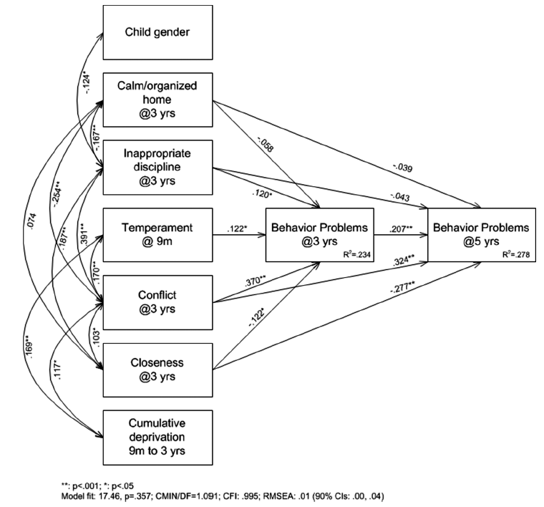

Slide 26
Mother mental health effects
[Totsika, Hastings et al., 2013, Autism Research]
N = 132 from the Millennium Cohort Study identified with ASD by parent report at age 5
Child behaviour problems and maternal well-being in first three waves of MCS (9 months, 3 years, 5 years)
Three wave cross-lagged path models fitted using AMOS
Conceptual model fitted reflecting the reciprocal relationships between child behaviour problems and maternal well-being

Slide 27
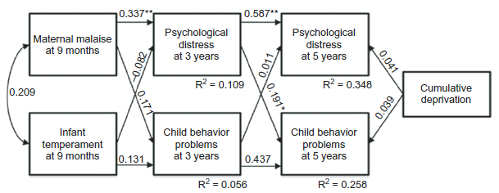
Mothers’ Kessler 6

Slide 28
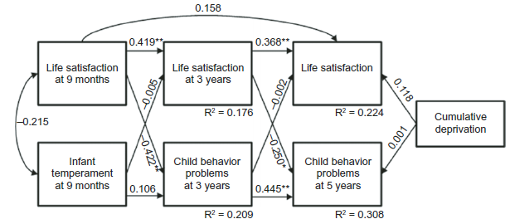
Mothers’ life satisfaction

Slide 29
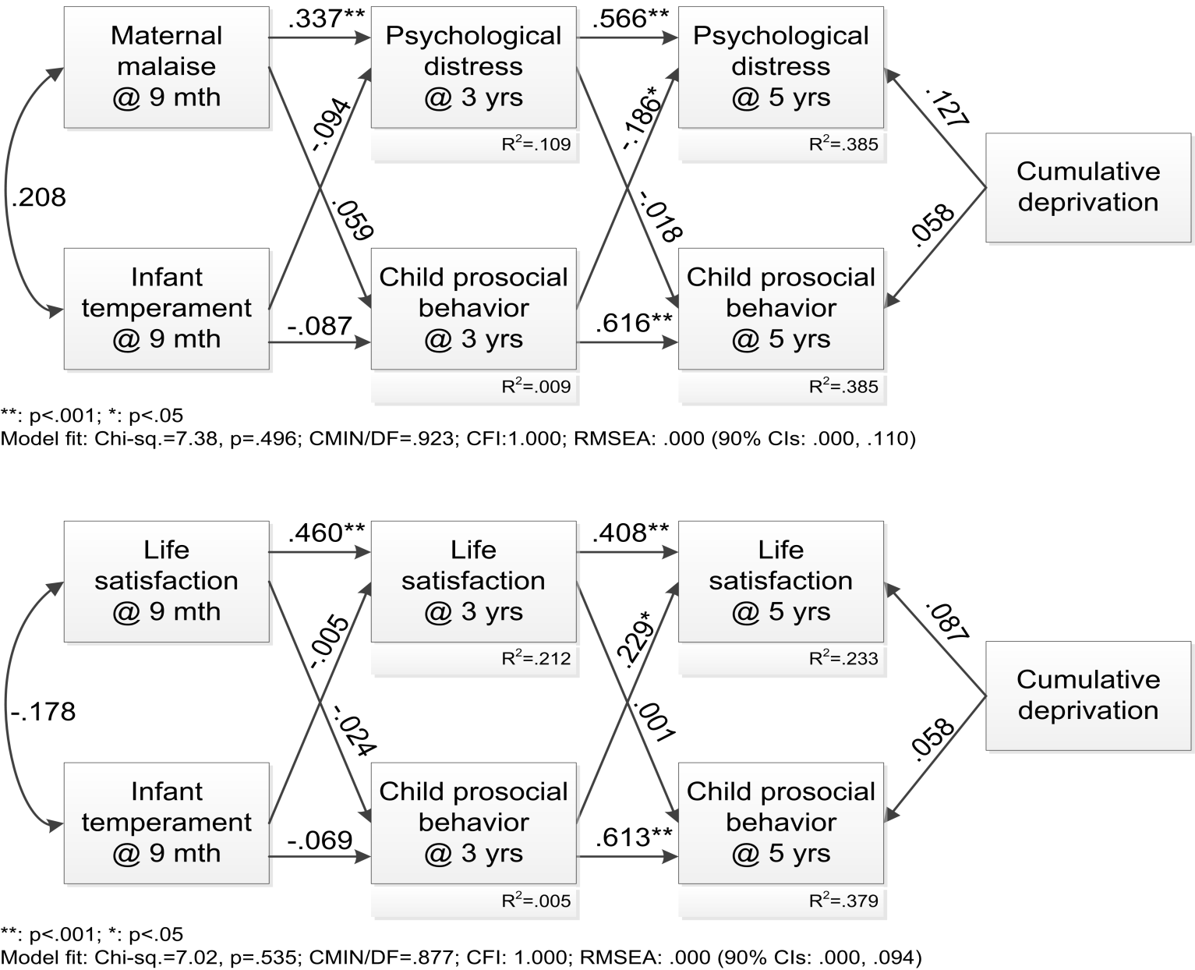
Child prosocial behaviour
[Totsika, Hastings et al. 2015 RASD]

Slide 30
Intervene how/where?
Current findings suggest interventions and services might (in addition to intervention with the child with autism) focus on: the roles of family adversity, parent mental health/well-being, adversarial parenting, parent-child relationship quality
Earlier child problems
Family stressors
Family patterns of interaction
Child behaviour outcomes
Hardship and family adversity
Parents’ emotional distress
Parenting

Slide 31
Brothers and sisters

Slide 32
Siblings - Parents’ worries
Having a brother or sister with autism might have a negative impact on siblings:
  Might cause stress and strain in the family
  “I have less time to spend with siblings”
  Increased responsibility (for the child with autism) placed on siblings
My children are not getting on well together – and one of them has autism
Advice and support for siblings?

Slide 33
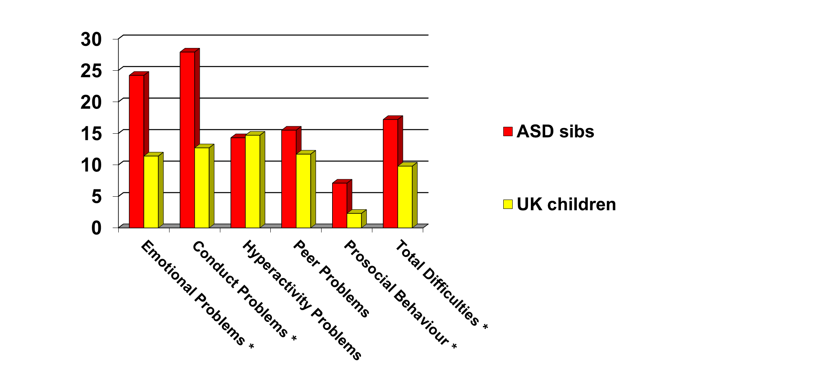
SDQ - 168 mothers’ reports
[Griffith, Hastings & Petalas, 2014]
(% clinical range)

Slide 34
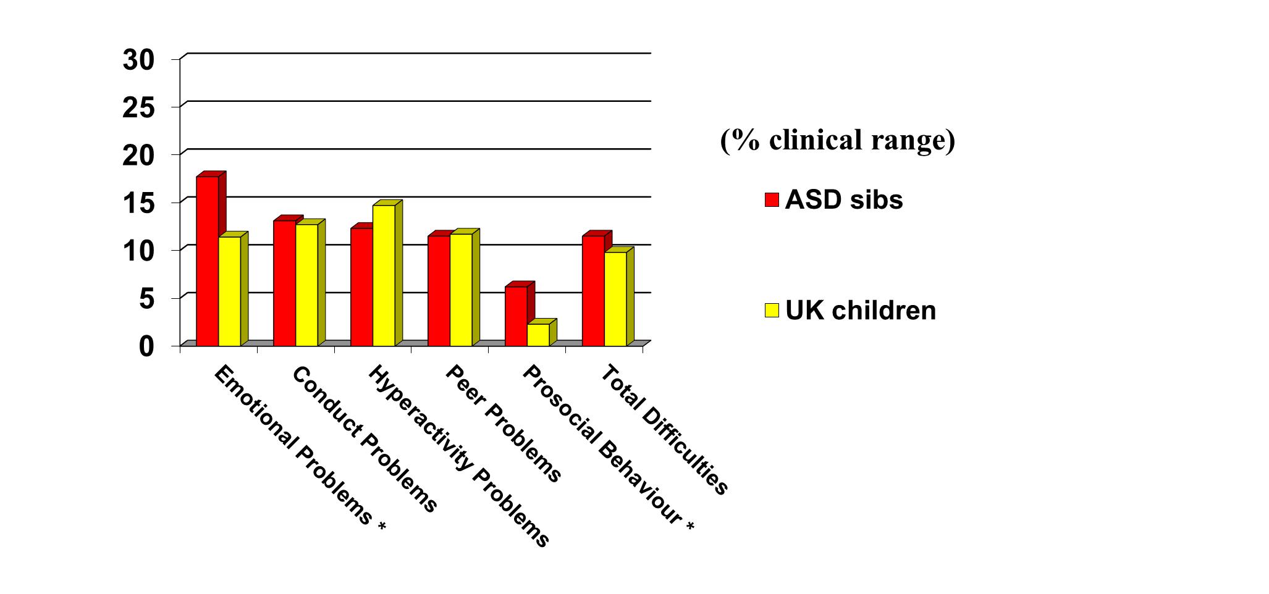
SDQ - 130 fathers’ reports
[Griffith, Hastings & Petalas, 2014]

Slide 35
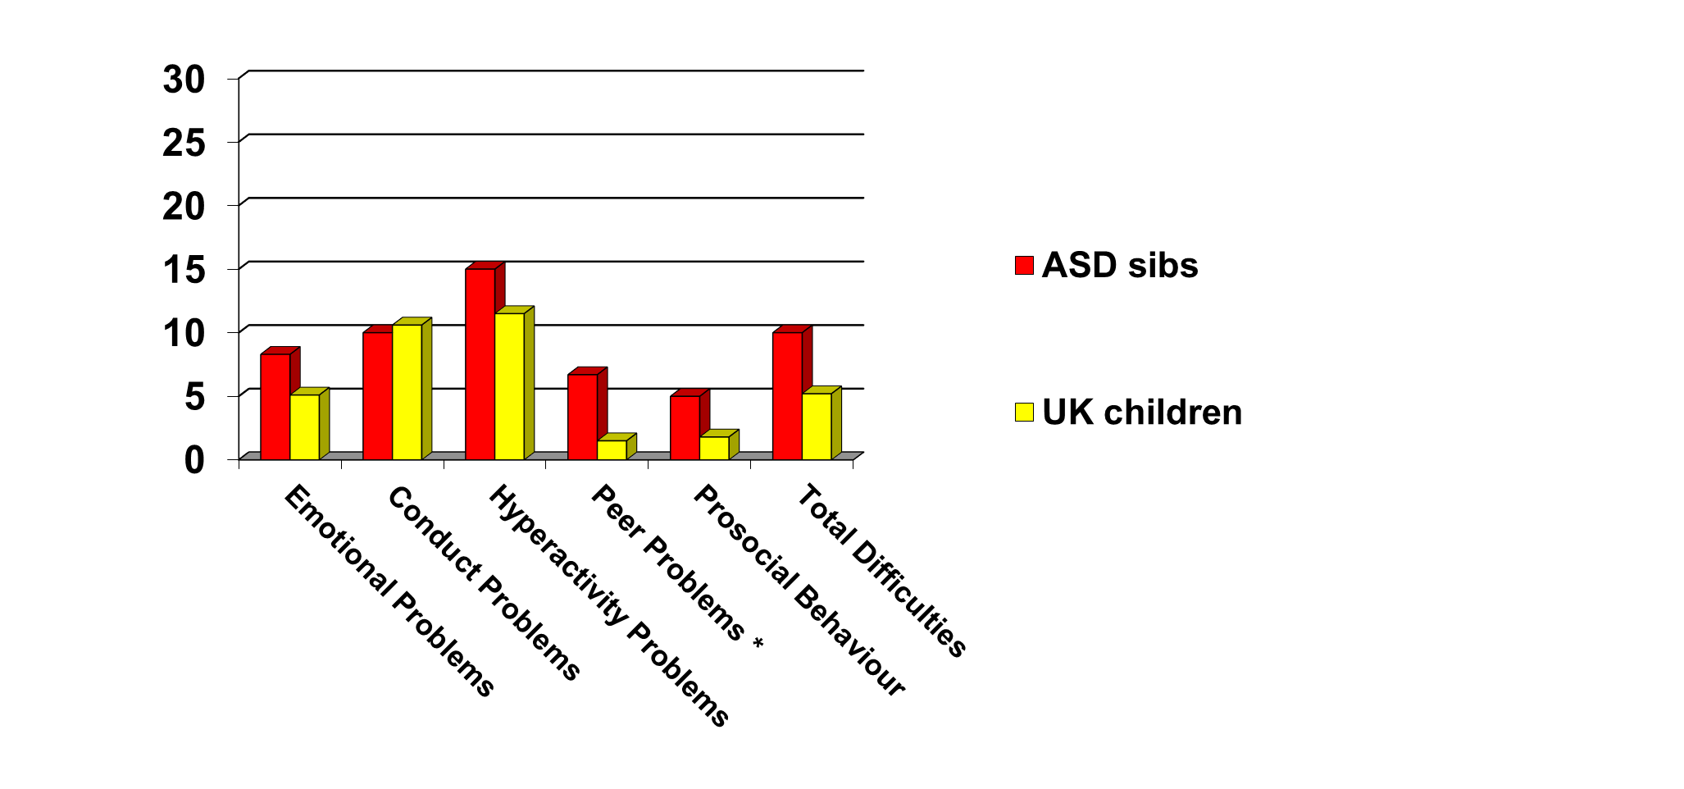
SDQ – 60 self-reports
[Hastings & Petalas, 2014]
(% clinical range)

Slide 36
Siblings’ well-being
Vast majority of siblings of children with autism do not have psychological adjustment problems
It matters who you ask
Any increased risk of problems compared to UK children and young people generally is small
In studies of siblings of children with autism, the factor most likely to predict whether siblings have problems of psychological adjustment is the behaviour problems of the child with autism

Slide 37
Sibling relationships
Relationship quality early research (parent and sibling report) suggested relationships were more positive with a disabled child in the family
More recent studies on siblings of children with autism provide mixed results
  The variable most likely to predict increased conflict and reduced warmth/closeness is the behaviour problems of the child with autism

Slide 38
Sibling groups - resources
Sibs UK, free information for parents, professionals, and free information for siblings group leaders
  https://www.sibs.org.uk/supporting-young-siblings/siblings-group-leaders/
Siblings Australia – SibworkS package (buy manuals)
  http://siblingsaustralia.org.au/resources.php
  [More CBT-focused; Roberts et al., 2015 controlled evaluation showed small post-intervention SDQ improvements]
Sibshops USA (buy manual)
  https://www.siblingsupport.org/publications/our-books/on-starting-a-sibshop

Slide 39
Effect of siblings’ BPs
[Hastings et al. 2014 RASD]
60 Families
Behavioural and emotional problems – child with ASD
Behavioural and emotional problems – child with ASD
Sibling behavioural and emotional problems
Maternal depression
2.5 to 3 years later

Slide 40
A system of supports
Providers of services should understand the needs of the population of children with autism and their families
Early intervention needs to extend to the family of children with autism
  Advocacy skills, and access to state benefits and community supports
  Parents’ skills: increasing adaptive and communication skills, managing behaviour problems, looking after the child’s emotional health, building positive parent-child relationships
  Direct interventions to improve family carers’ psychological well-being, whole family well-being, and family activities
  Education and social support for siblings and direct evidence-based interventions for siblings’ behaviour problems
Services need a lifespan perspective: continued and conceptually consistent support is needed, especially at key transitions

Slide 41

R.Hastings@warwick.ac.uk
@ProfRHastings
http://profhastings.blogspot.co.uk/
Funders – ESRC, Cerebra, Baily Thomas Charitable Fund, European Social Fund, National Autistic Society, NIHR

